Slide 1

Collaborative Music Production
Damon Siseman
Ciarán jai cosway

Slide 2
Project Overview
I came to university with the hope of being able to write and produce my own music, but I had no idea where or how to start
I decided to collaborate with my friend Ciarán as we have known each other for a long time and have similar musical interests
We believe our separate compositional styles will be complementary to each other

Slide 3

My Background
I have a small amount of experience in making my own music which is an electronic chillwave kind of style, for example my first EP ‘23:45’ which was released a few months ago.
I will typically use a combination of virtual synthesizers and samples to create music.
I also find that my interest in classical piano, particularly Impressionism, helps to inform compositional choices.
Track: ‘Its Alright Here’

Slide 4
Ciarán’s Background
@ciarancosway
Ciarán is a freelance music composer and sound designer for video games and other media.
His work is all centered around video games and so he has composed in a wide variety of styles and genres.
He has expertise in guitar and vocals as well as the Japanese shakuhachi flute.

Slide 5
Project Context
One example which inspired me is the collaborative work of vaporwave artist George Clanton and alternative rock artist Nick Hexum of 311.
They released two singles ‘Crash Pad’ and ‘King for a Day’ in September 2019.

Slide 6
Project Aims and Outcomes
The aim is to have a pair of songs released onto major streaming sites such as Spotify, Apple Music, etc.
I am also aiming to improve my skills in music production and learn new things.

Slide 7
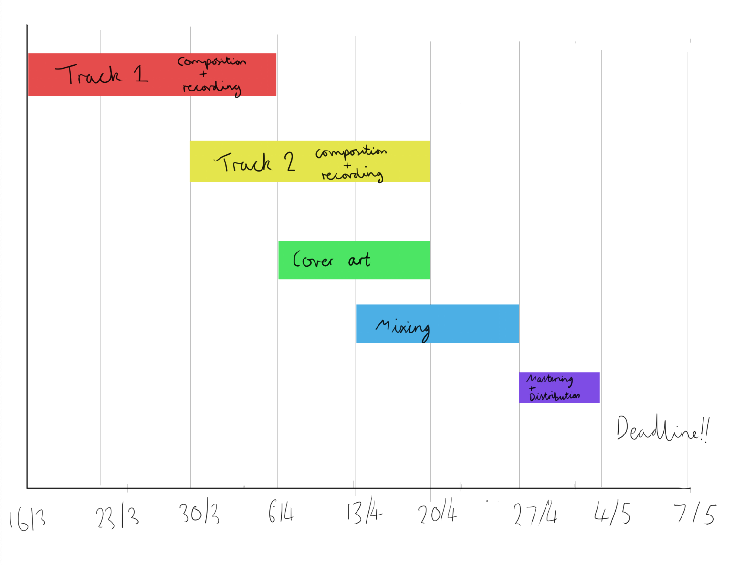
Timeline
Gantt chart I made at the start of this week to keep us on track.

Slide 8
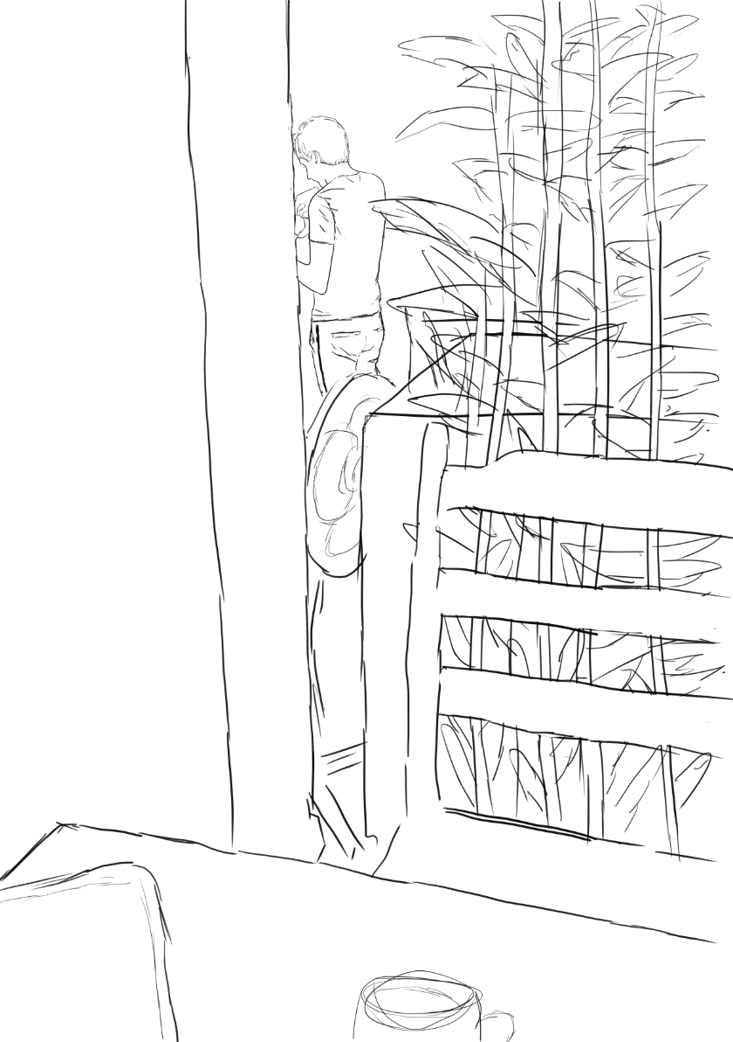
Progress To Date
So far we have mainly been experimenting with different ideas such as this below:
Here is a little sketch I did a few days ago which I might re-do and paint to use as cover art

Slide 9
Bibliography
Bandcamp, (2019). Crash Pad​/​King for a Day. [online] Available at: https://georgeclanton.bandcamp.com/album/crash-pad-king-for-a-day [Accessed 29th February 2020).
Clark, W. (1922). The Gantt Chart: A Working Tool of Management. New York: The Ronald Press Company.
Hansen, M. (2009). Collaboration: How Leaders Avoid the Traps, Build Common Ground, and Reap Big Results. Boston, Massachusetts: Harvard Business Press.
Huxham, C. and Vangen, G. (2005). Managing to Collaborate : The Theory and Practice of Collaborative Advantage. Abingdon, Oxon: Routledge.
Man, B. D., Stables, R., and Reiss, J. D. (2020). Intelligent Music Production. New York: Routledge.
Pejrolo, A. (2014). Remote Collaboration: Long Distance Recording Projects. [online] Sound On Sound. Available at: https://www.soundonsound.com/techniques/remote-collaboration [Accessed 17th March 2020].
Shafer, E. (2019). 311's Nick Hexum & George Clanton Evoke 'The Ultimate Nostalgic Experience' on 'Crash Pad': Exclusive. [online] Billboard.com. Available at: https://www.billboard.com/articles/news/8531401/311-nick-hexum-george-clanton-collab-two-singles [Accessed 29th February 2020].

